Slide 1
Module 3
K – means clustering Algorithm

Slide 2
Role of K-means clustering in financial data Analysis
Customer Segmentation
Fraud Detection
Asset Allocation
Risk Management
Market Segmentation for Financial Products
Analyzing Financial Time Series Data
Anomaly Detection in Financial Data

Slide 3
Example in Finance: Customer Segmentation for a Bank
Let’s say a bank wants to segment its customers based on their usage of various services. The bank has data on customer behavior, including:
Account balances
Transaction frequency
Loan history
Age
Income level

Slide 4
Using K-means clustering, the bank can segment its customers into different groups:
Cluster 1: Young customers with moderate income, frequent transactions, and high usage of digital banking.
Cluster 2: Older customers with high account balances and infrequent transactions.
Cluster 3: Middle-aged customers with a history of using loans and moderate account activity.

Slide 5
By analyzing these clusters, the bank can offer personalized services:
Tailored loan products for Cluster 3.
Targeted savings accounts for Cluster 2.
Digital banking features for Cluster 1.

Slide 6
Steps for k-means Algorithm
Initialization: Randomly choose K centroids.
Assign Points: For each data point, calculate the distance to each centroid and assign it to the
closest centroid.
Update Centroids:
For each cluster, sum the feature values of all points assigned to that cluster.
Calculate the new centroid as the average of those points (the sum of points divided by the number of points in the cluster).
Repeat: Reassign points and update centroids. Continue until centroids no longer change significantly (convergence).

Slide 7
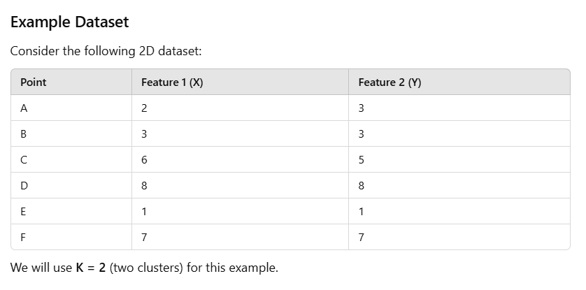

Slide 8
Sparsity and Connectedness of Undirected Graph
Graphs can be used to model various types of relationships, such as between assets, companies, or individuals.
Understanding connectedness and sparsity of these graphs is crucial for analyzing networks in finance, such as portfolio diversification, credit networks, market interactions, and fraud detection

Slide 9
Financial Asset Network (Portfolio Diversification)
In portfolio diversification, we can model the relationship between different financial assets (e.g., stocks, bonds, commodities) using a graph, where:
Vertices (nodes) represent different financial assets.
Edges represent relationships between assets, often based on correlations or co-movements in price changes over time.
Sparsity in a Financial Asset Network:
In a sparse asset network, there may be only a few assets with strong correlations or co-movements (i.e., the edges between most of the assets are weak or nonexistent).

Slide 10
Financial Asset Network (Portfolio Diversification)
Connectedness in a Financial Asset Network:
Connectedness in this context would mean that there is a way to reach every asset through a path of correlated assets.
  Fully connected graph
  Disconnected graph

Slide 11
Example:
Imagine a portfolio consisting of 10 assets, and the edge weights between these assets represent how correlated their prices are (with strong correlation meaning a heavier edge). After calculating the correlations:
Assets 1, 2, and 3 are strongly correlated and form a connected subgraph.
Assets 4, 5, and 6 are loosely correlated and form another disconnected subgraph.
Assets 7, 8, 9, and 10 are highly uncorrelated with each other and other assets, meaning they are isolated.
In this case:
The portfolio's overall connectedness would be low (indicating strong diversification).
The graph is sparse, because not every asset is strongly correlated with others.

Slide 12
Credit Network (Risk and Default Propagation)
In a credit network, the nodes represent financial institutions (banks, companies, etc.), and the edges represent credit relationships or loans between these institutions. The network can be used to analyze the spread of financial risks, defaults, or contagion in the financial system.
Sparsity in a Credit Network:
A sparse credit network could occur when banks or companies only have limited credit relationships with others.

Slide 13
Credit Network (Risk and Default Propagation)
Connectedness in a Credit Network:
Connectedness in a credit network indicates the spread of risk and the propagation of defaults. If the network is connected, the failure of a single institution could cause default contagion, meaning it could lead to the failure of other connected institutions due to their interdependencies.
Highly connected Graph
Disconnected Graph

Slide 14
Example:
Suppose you have a credit network with 8 financial institutions, and the edges represent direct credit relationships (loans or guarantees between them):
If institutions 1, 2, and 3 are connected, but institutions 4, 5, 6, 7, and 8 are only loosely connected, the network is disconnected. This suggests that if one of the connected institutions defaults (say, institution 1), it may not affect institutions 4-8, because they are not strongly linked.
However, if institutions 1, 2, 3, 4, 5, 6, 7, and 8 are all interconnected, the network is connected, meaning that the failure of any institution could quickly lead to a cascading failure, as they all have links to each other.

Slide 15
Conclusion
Sparsity in Finance: A sparse graph typically indicates fewer relationships between entities, which might reduce risks (e.g., less contagion in credit networks) or allow for better diversification (e.g., in asset allocation).
Connectedness in Finance: A connected graph suggests a higher risk of systemic failure or contagion, as the failure of one institution or asset could lead to a cascade affecting others. In contrast, disconnected graphs can help isolate risks and enhance diversification.

Slide 16
Covariance and Precision Matrices

Slide 17
Covariance Matrix
The covariance matrix is a square matrix that represents the covariance (a measure of how much two variables change together) between multiple variables. In finance, these variables are often asset returns.
Positive covariance
Negative covariance
Zero covariance

Slide 18
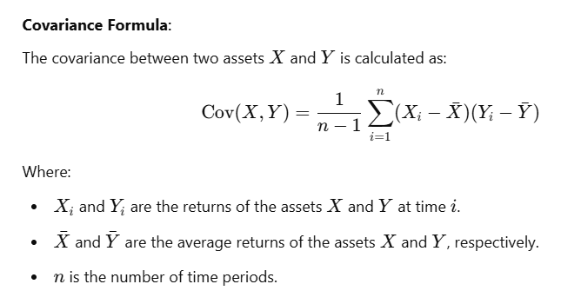
Formula

Slide 19
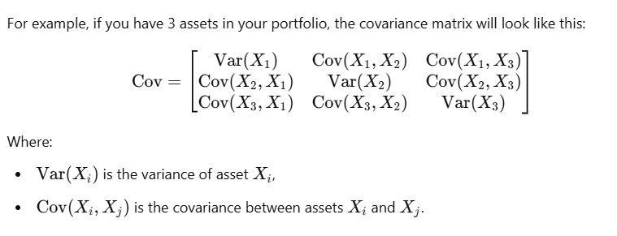
Example of Covariance matrix

Slide 20
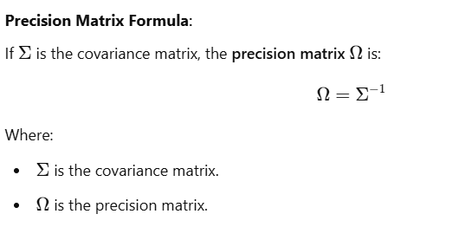
Precision Matrix
The precision matrix is the inverse of the covariance matrix.
It is used in statistics and finance to understand the conditional dependence between random variables.

Slide 21
Properties of Precision Matrix
The diagonal elements of the precision matrix represent the conditional variances of individual assets, which can be interpreted as the variance of each asset after accounting for all other assets in the portfolio.
The off-diagonal elements of the precision matrix reflect the conditional dependencies between assets. If an off-diagonal element is large (in magnitude), it indicates a strong conditional dependence between the two assets.

Slide 22
Covariance vs Precision Matrix in Finance
Covariance Matrix:
Focuses on the direct relationships between assets.
Used to assess overall portfolio risk and diversification.
The elements of the covariance matrix represent co-movements of asset returns.
Precision Matrix:
Focuses on conditional relationships between assets (i.e., relationships after accounting for other variables).
Used to model indirect dependencies and can be useful in advanced portfolio optimization and
risk management.
The precision matrix gives more insights into the sensitivity of asset returns to each other after controlling
for other assets.

Slide 23
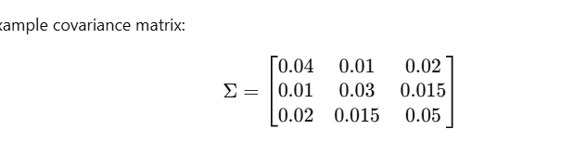
Example in Finance: Portfolio Management
Let’s say you have a portfolio of three assets, and you want to understand their relationships and risks.
Step 1: Covariance Matrix: You calculate the covariance matrix for the assets' returns over the past year. This matrix will show you:

Slide 24
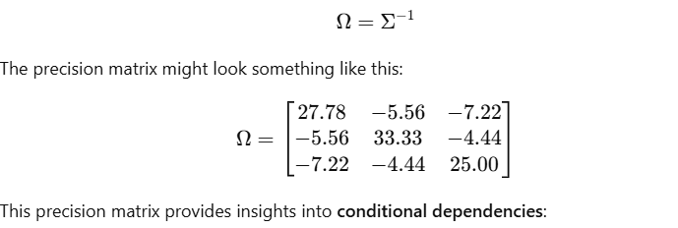
Example in Finance: Portfolio Management
Step 2: Precision Matrix: Next, you compute the precision matrix by taking the inverse of the covariance matrix:

Slide 25
If the covariance matrix Σ has a large positive covariance between two variables, this means that they tend to move together. The inverse of this large value (in the precision matrix) will be small, and the conditional dependence is weak or positive.
Conversely, if the covariance matrix Σ\SigmaΣ has a negative covariance between two variables, this will lead to a positive value in the precision matrix (after inversion).

Slide 26
